Slide 1
Basic & Advanced SAS Graphics Course
NESUG
September 2006
Phil Mason

Slide 2
Class Material
Covers the advanced material
Should have had the basic, but that is available at www.woodstreet.org.uk/files/nesug/graphics.mdi

Slide 3
Who is Phil Mason?
An Australian living in England and working in Wales
21years of daily SAS use
Wrote a book or two
Presented many papers, courses
Involved in user groups: SMUG, VIEWS, SEUGI, UK Forum, NESUG, MWSUG, SUGI, BLUES, Pharmasug, PSI
Little known facts!
  Been doing volunteer youth work for 25 years
  A wife & 3 kids keep me busy

Slide 4
Evolution of this course
Tips & papers
Led to book
Led to courses
Led to Graphics course
Led to basic & advanced Graphics courses
Led to many updates and changes for SAS 9 releases
And here we are!

Slide 5
What do you know about ODS?
Who has used it?
How much?
What destinations?
What systems do you use SAS on?
What versions of SAS?

Slide 6
Course Overview
Introduction to SAS/Graph
Intermediate SAS/Graph
Advanced Graphics

Slide 7
Introduction to SAS/Graph

Slide 8
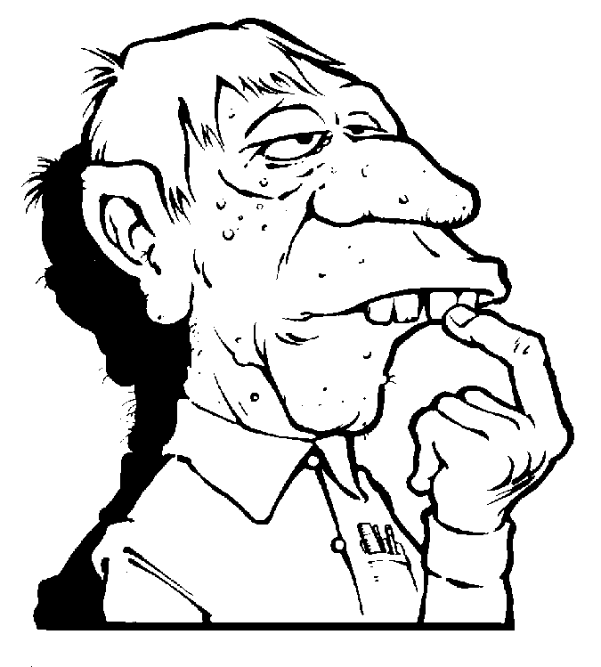
Overview
Outline basic functions for each procedure
Demonstrate via examples
SAS is a registered trademark or trademark of SAS Institute Inc. in the USA and other countries. ® indicates USA registration.
Other brand and product names are registered trademarks or Trademarks of their respective companies.

Slide 9
Introduction
SAS/Graph is a separate product - you either buy it or you don’t
Allows graphics to be produced by using various procedures
Can be highly customized & automated
Very extendable using two graphics sub-languages provided

Slide 10
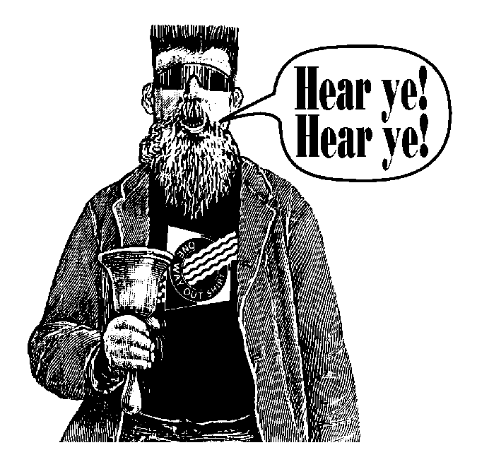
Topics to be Covered
Categories
  Plotting & Mapping procedures
  Printing & Displaying procedures
  Graphics Utility procedures
  Graphics Statements & Windows
  Sub-languages

Slide 11
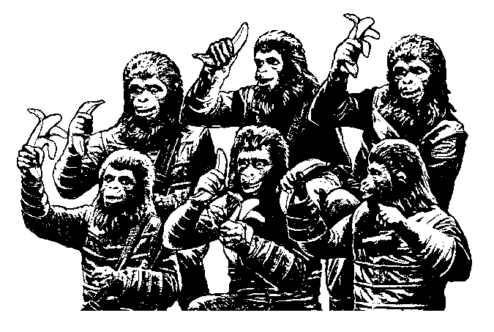
Plotting & Mapping Procedures
Charting & Plotting
  GCHART
  GPLOT
3D plotting
  GCONTOUR
  G3D
  G3GRID
Mapping
  GMAP
  GPROJECT
  GREDUCE
  GREMOVE

Slide 12
GCHART
Simple vertical bar chart
Specifying y-axis
Sub-grouping bars
Grouping bars
Horizontal bars
Pie Chart
Star Chart
Demo
Demo
Demo
Demo
Demo
Demo
Demo

Slide 13
GPLOT
Demo
Plotting points on x & y axes
Joining points to make lines
Plotting multiple lines
Creating a separate plot per variable
Overlaying separate plots
2 y-axes with different scales
Bubble plot
2 y-axes on a bubble plot
Demo
Demo
Demo
Demo
Demo
Demo
Demo

Slide 14
New SAS 9 Procedures
Proc Gbarline
  Combined Bar Chart & Line Graph
Proc Gareabar
  Bar chart where bar width controlled by variable
Proc Mapimport
  Import mapping coordinates from ESRI
  These are described later in more detail

Slide 15
GCONTOUR
Simple Contour Chart
Adding a pattern
Demo
Demo

Slide 16
G3D
3D graph - x, y & z axes
Identifying each data point
Demo
Demo

Slide 17
G3GRID
Interpolates values in incomplete data for use with G3D
Produce “Cowboy Hat” with missing data
Interpolate data and plot it
Demo
Demo

Slide 18
GMAP
Maps showing areas in different colors
Bars indicating values for regions
Prisms height represents values for regions
3D surface map where height represents values
State/Province detail provided for some countries
Demo
Demo
Demo
Heavy Processing
Demo
Demo

Slide 19
GPROJECT
Converts spherical co-ordinates to Cartesian co-ordinates
  e.g. a globe to a flat map

Slide 20
GREDUCE
Reduces the detail in the map
Before...
...and After
Demo

Slide 21
GREMOVE
Removes map borders to combine smaller areas into larger ones

Slide 22
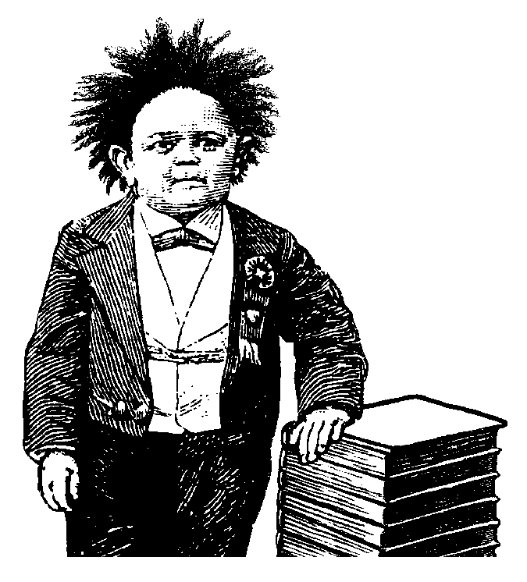
Printing & Displaying Procedures
GREPLAY
GANNO
GSLIDE
GPRINT

Slide 23
GREPLAY
Allows multiple graphs to be combined
  Interactively
  Batch
Pre-defined templates are provided
  SASHELP.TEMPLT
Demo
Demo

Slide 24
GANNO
Displays graphics produced by an annotate dataset
Macros are provided
  makes generating datasets easier
  define by executing:
    %annomac;
Example later in presentation

Slide 25
GSLIDE
Displays text in a graphic
Can also display annotate data
Demo

Slide 26
GPRINT
Allows text from a file to be converted
to graphics
Can use ANNOTATE graphics too
Demo

Slide 27
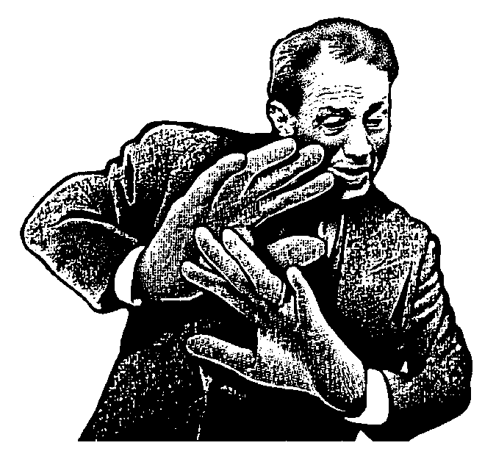
Graphics Utility Procedures
GDEVICE
GFONT
GIMPORT
GKEYMAP
GOPTIONS
GTESTIT
VEDIT

Slide 28
GDEVICE
Defines or Modifies SAS device drivers
  Interactive
  Batch
Can then use device drivers in SAS for printing or viewing graphics
  Some drivers simply pass through to windows drivers
    “WIN” displays graphics in Windows
    “WINPRTC” color print with Windows
Demo
Demo

Slide 29
GFONT
Displays SAS fonts
Creates SAS fonts
Can also modify or delete SAS fonts
These fonts can be used throughout SAS/Graph
Demo
Demo

Slide 30
GIMPORT
Imports graphics from CGM format
Useful since you can convert your graphics to CGM and then import into SAS
There is a better graphic import facility
  Global - Manage - Import Image

Slide 31
GKEYMAP
Used to generate characters not available on keyboard

Slide 32
GOPTIONS
Displays all graphics options and their settings
Demo

Slide 33
GTESTIT
Produces 3 graphics
Used to test configuration of devices
Demo

Slide 34

Graphics Statements & Windows
Text Control
  TITLE
  FOOTNOTE
  NOTE
System Control
  GOPTIONS
Design Control
  AXIS
  SYMBOL
  PATTERN
  LEGEND
Example
Demo

Slide 35
TITLE
Text appear at top of graphic
Up to 10 Title statements
Can specify text attributes
  Color, Font, Size, Angle, Justification, etc.
Demo

Slide 36
FOOTNOTE
Same features as TITLE, except text appears at bottom of graphic
Demo

Slide 37
NOTE
Same features as TITLE, except text appears after TITLE and before FOOTNOTE

Slide 38
GOPTIONS
Many options to control graphic output, such as:
  cback=yellow … yellow background
  border … puts border around graphic
  nodisplay … don’t display graphic
  colors=(r g b p) … colors to use for elements of graphic in order
Demo

Slide 39
AXIS
Control location, values & appearance of axes
Use the axis definition from the procedure, e.g.
  Haxis=axis1 … Vaxis=axis2
Example
  axis1 c=purple style=4 label=(‘axis label’) value=(‘tick1’ ‘tick2’) width=3 ;
Demo

Slide 40
SYMBOL
Specify various things with GPLOT & GCONTOUR procedures, including
  Change plot symbol
  Connect points to form lines, e.g.
    Straight line join
    Needle
    Steps
    Spline
Demo

Slide 41
PATTERN
Controls pattern of:
  area under a line
  vertical or horizontal bars
  areas of maps
  areas of pie or start chart slices
Demo

Slide 42
LEGEND
Defines appearance and position of Legend, e.g.
  Number of items across & down
  Shape of legend items: bar, line or symbol
  Position of legend: top/middle/bottom, left/center/right, inside/outside borders
Demo

Slide 43
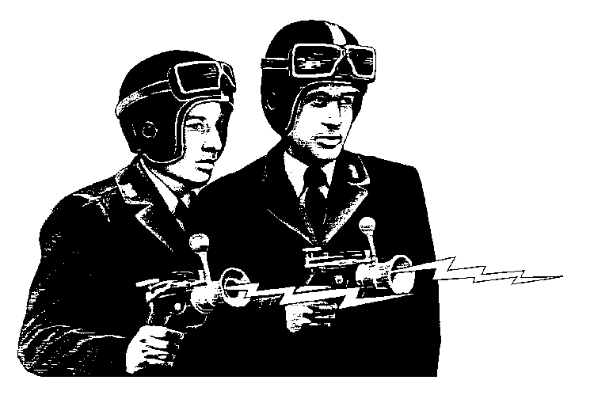
Sub-Languages
Fonts
Annotate
DSGI
  Data Step Graphics Interface

Slide 44
FONTS
Not really a language
  but could be considered as such in that fonts can be defined
Can be used throughout SAS/Graph
Can be defined via PROC GFONT
Fonts stored in SASHELP.FONTS
Can import Windows Fonts for use with SAS/Graph

Slide 45
ANNOTATE
Define the macros using %annomac (if you want to use them)
Create a dataset
Display it
  using PROC GANNO
  using ANNOTATE= in various procedures
Demo

Slide 46
DSGI
Data Step Graphics Interface
  Allows graphics to be constructed from Data Step or SCL
  Can draw various items such as:
    Bars, Arcs, Lines, Pies, Text, etc.
  Very, very flexible
    Can draw almost anything
Demo

Slide 47

Conclusion
Advantages of SAS/Graph over other packages
Wide range of graphs with a flexible collection of options
Total control over all elements of graphs via many options, DSGI & Annotate facilities
Can generate large numbers of graphs
Allows multiple graphs per page via templates

Slide 48
Any Questions?
That’s all for the basics

Slide 49
Intermediate SAS/Graph
A little more advanced

Slide 50
Agenda
Common elements
  Units, colors, devices
Key statements
  Title, Footnote & Note
  Symbol, pattern
  Axis, Legend
Key procedures
  Proc Gplot
  Proc Gchart
Enhancing graphs
  Annotate
More examples

Slide 51
Common elements
Units
Colors
Devices

Slide 52
Units
CELLS | character cells
CM | centimeters
IN | inches
PT | Points
PCT | percentage of the graphics output area

Slide 53
Colors
The valid color-naming schemes are
  RGB (red green blue)
  CMYK (cyan magenta yellow black)
  HLS (hue lightness saturation)
  HSV (hue saturation brightness), also called HSB
  gray scale
  predefined SAS color names.

Slide 54
Example Colors
RGB, green … CX00FF00
CMYK, green … 'FF00FF00'
HLS, bright blue … H14066FF
HSV, bright blue … V0C8FFCC
Gray scale, dark gray … GRAY4C
SAS/Graph … Green, DEep Blue, Very Pale Gray Red

Slide 55
Devices
Options device=win ;
To view/change use Proc gdevice
Useful device drivers
  Win
  Winprtc, winprtg
  Jpeg, Gif, gifanim
  Activex, java
  Pdf, pdfc

Slide 56
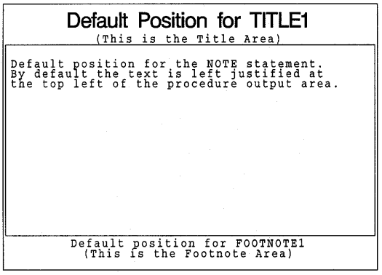
Title, Footnote & Note

Slide 57
Syntax
Title[1-10] [text argument(s)]
Note[1-10] [text argument(s)]
Footnote[1-10] [text argument(s)]
  Text-argument(s)
    ‘text=string’
    Text-options

Slide 58
Appearance options
COLOR=color
FONT=font
HEIGHT=text-height<units>

Slide 59
Placement and spacing options
JUSTIFY=LEFT | CENTER | RIGHT
LSPACE=line-space<units>
MOVE=(x,y)<units>

Slide 60
Baseline angling and character rotation options
ANGLE=degrees
LANGLE=degrees
ROTATE=degrees

Slide 61
Example
proc gslide ;
title1 c=red f=swiss h=3 j=l 'My drug trial' j=c 'PPD' j=r "&sysdate" ;
title2 c=green f=titalic h=2 j=c langle=30 'Biostatistics' ;
footnote1 c=blue f=swissb angle=90 h=4 'all mixed up' ;
footnote2 c=purple f=italic h=3 rotate=90 'Produced by SAS' ;
run ;

Slide 62
Boxing, underlining, and line drawing options
BCOLOR=background-color
BLANK=YES
BOX=1...4
BSPACE=box-space<units>
DRAW=(x,y...,x-n,y-n)<units>
UNDERLIN=0...3

Slide 63
Symbol syntax
SYMBOL<1...99>
<COLOR=symbol-color>
<MODE=EXCLUDE | INCLUDE>
<REPEAT=number-of-times>
<STEP=distance<units>>
<appearance-option(s)>
<interpolation-option>;

Slide 64
Appearance-options
BWIDTH=box-width
CI=line-color
CO=color
CV=value-color
FONT=font
HEIGHT=symbol-height<units>
LINE=line-type
POINTLABEL<=(label-description(s)) | NONE>
VALUE=special-symbol | text-string | NONE
WIDTH=thickness-factor

Slide 65
interpolation-option
general methods
  INTERPOL=JOIN
  INTERPOL=map/plot-pattern
  INTERPOL=NEEDLE
  INTERPOL=NONE
  INTERPOL=STEP<placement><J><S>
high-low interpolation methods
  INTERPOL=BOX<option(s)><00...25>
  INTERPOL=HILO<C><option(s)>
  INTERPOL=STD<1 | 2 | 3><variance><option(s)>
regression interpolation methods
  INTERPOL=R<type><0><CLM | CLI<50...99>>
spline interpolation methods
  INTERPOL=L<degree><P><S>
  INTERPOL=SM<nn><P><S>
  INTERPOL=SPLINE<P><S>

Slide 66
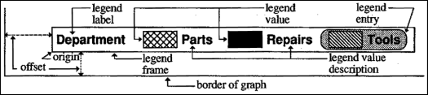
Key parts of a legend
Syntax
  Legend[1-99] [options] ;

Slide 67
appearance options
ACROSS=number-of-columns
CBLOCK=block-color
CBORDER=frame-color
CFRAME=background-color
CSHADOW=shadow-color
DOWN=number-of-rows
FRAMEFWIDTH=thickness-factor
SHAPE=BAR(width,height) <units> | LINE(length) <units> | SYMBOL(width,height) <units>

Slide 68
position-options
MODE=PROTECT | RESERVE | SHARE
OFFSET=(<x ><,y >)<units > | (<x <units >><,y <units >>)
ORIGIN=(<x ><,y >)<units > | (<x <units >><,y <units >>)
POSITION=(<BOTTOM | MIDDLE | TOP> <LEFT | CENTER | RIGHT> <INSIDE | OUTSIDE>)

Slide 69
text-options
LABEL=(text-argument(s)) | NONE
ORDER=(value-list)
VALUE=(text-argument(s)) | NONE

Slide 70
Pattern statement
PATTERN<1...99>
<COLOR=pattern-color>
<REPEAT=number-of-times>
<VALUE=bar/block-pattern
| map/plot-pattern
| pie/star-pattern
| hardware-pattern>;

Slide 71
bar/block-pattern can be one of these:
EMPTY … empty pattern
SOLID … solid pattern
style <density> … shaded pattern
  Style specifies the direction of the lines:
  L … left-slanting lines.
  R … right-slanting lines.
  X … cross hatched lines.
  Density … density of pattern's shading:
    1 to 5 … 1 produces the lightest shading
      and 5 produces the heaviest shading.

Slide 72
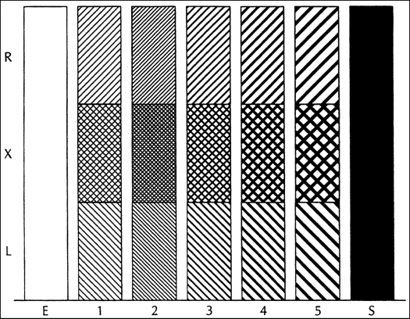
Bar & Block Patterns

Slide 73
map/plot-pattern can be one of these:
MEMPTY
MSOLID
Mdensity <style <angle>>
  Density … density of the pattern's shading:
    1 to 5 … 1 lightest shading and 5 heaviest shading.
  Style … type of the pattern lines:
    N … parallel lines (the default).
    X … crosshatched lines.
  Angle … angle of the pattern lines:
    0 to 360 … degrees at which the parallel lines are drawn, measured from the horizontal. By default, angle is 0 (lines are horizontal).

Slide 74
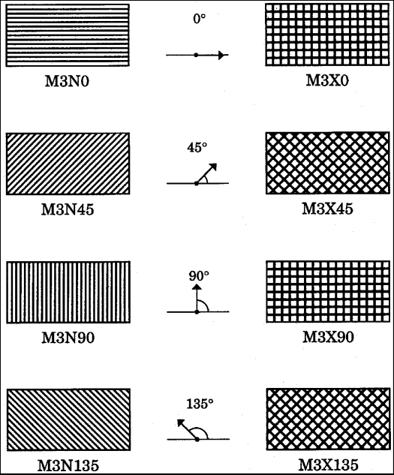
Map & Plot Patterns

Slide 75
pie/star-pattern can be one of these:
PEMPTY
PSOLID
Pdensity <style <angle>>
  Density … density of the pattern's shading:
    1 to 5 …1 lightest shading and 5 heaviest shading.
  Style specifies the type of the pattern lines:
    N … parallel lines (the default).
    X … crosshatched lines.
  Angle … angle of the pattern lines:
    0 to 360 … angle of the lines, measured in degrees from perpendicular to the radius of the slice. By default, angle is 0.

Slide 76
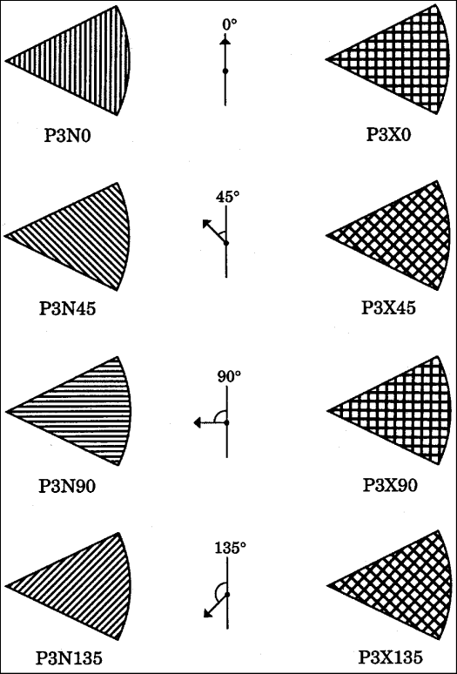
Pie & Star Patterns

Slide 77
hardware-pattern has this form
HWxxxnnn … pattern as a hardware pattern.
  The pattern name must begin with the characters HW.
  Xxx … the last two or three characters of the module name in the Module field in the Detail window of your device entry.
  Nnn … the number the driver uses to identify the device-dependent pattern.

Slide 78

Axis statement
AXIS<1...99><options>;

Slide 79
axis scale options:
LOGBASE=base | E | PI
LOGSTYLE=EXPAND | POWER
ORDER=(value-list)

Slide 80
appearance options:
COLOR=axis-color
LENGTH=axis-length <units>
NOBRACKETS
NOPLANE
OFFSET=(<n1 ><,n2 >)<units > | (<n1<units>><,n2<units >>)
ORIGIN=<(x><,y >)<units> | (<x<units >><,y<units>>)
STYLE=line-type
WIDTH=thickness-factor

Slide 81
tick mark options:
MAJOR=(tick-mark-suboption(s) ) | NONE
MINOR=(tick-mark-suboption(s) ) | NONE

Slide 82
text options:
LABEL=(text-argument(s) ) | NONE
REFLABEL=(text-argument(s) ) | NONE
SPLIT="split-char“
VALUE=(text-argument(s) ) | NONE

Slide 83
GOPTIONS
GOPTIONS<options-list>;
  options-list can be one or more options
Reset option
  RESET=ALL | GLOBAL | statement-name | (statement-name(s))
Now, for many, many more GOPTIONS…

Slide 84
options that affect the appearance of the display area and the graphics output
ASPECT=scaling-factor
AUTOSIZE=ON | OFF | DEFAULT
BORDER | NOBORDER
CELL | NOCELL
GSIZE=lines
HORIGIN=horizontal-offset <IN | CM>
HPOS=columns
HSIZE=horizontal-size <IN | CM>
ROTATE=LANDSCAPE | PORTRAIT
ROTATE | NOROTATE
SWAP | NOSWAP
TARGETDEVICE=target-device-entry
VORIGIN=vertical-offset <IN | CM>
VPOS=rows
VSIZE=vertical-size <IN | CM>
XMAX=width <IN | CM>
XPIXELS=width-in-pixels
YMAX=height <IN | CM>
YPIXELS=height-in-pixels

Slide 85
options that affect color
CBACK=background-color
CBY=BY-line-color
COLORS=<(colors-list | NONE)>
CPATTERN=pattern-color
CSYMBOL=symbol-color
CTEXT=text-color
CTITLE=title-color
PENMOUNTS=active-pen-mounts
PENSORT | NOPENSORT

Slide 86
options that control font selection or text appearance
CHARTYPE=hardware-font-chartype
FASTTEXT | NOFASTTEXT
FBY=BY-line-font
FCACHE=number-fonts-open
FONTRES=NORMAL | PRESENTATION
FTEXT=text-font
FTITLE=title-font
FTRACK=LOOSE | NONE | NORMAL | TIGHT | TOUCH | V5
HBY=BY-line-height <units>
HTEXT=text-height <units>
HTITLE=title-height <units>
RENDER=APPEND | DISK | MEMORY | NONE | READRENDERLIB=libref
SIMFONT=software-font

Slide 87
options that set defaults for procedures and global statements
GUNIT=units
INTERPOL=interpolation-method
OFFSHADOW=(x <units>, y <units> | (x,y) <units>
V6COMP | NOV6COMP

Slide 88
image animation options
DELAY=delay-time
DISPOSAL=NONE | BACKGROUND | PREVIOUS | UNSPECIFIEDINTERLACED | NONINTERLACED
ITERATION=iteration-count
TRANSPARENCY | NOTRANSPARENCY

Slide 89
options that affect how your SAS/GRAPH program runs
DISPLAY | NODISPLAY
ERASE | NOERASE
GWAIT=seconds
GRAPHRC | NOGRAPHRC
PCLIP | NOPCLIP
POLYGONCLIP | NOPOLYGONCLIP

Slide 90
options that control how output is sent to devices or files
ADMGDF | NOADMGDF
DEVADDR=device-address
DEVICE=device-entry
DEVMAP=device-map-name | NONE
EXTENSION='file-type‘
FILECLOSE=DRIVERTERM | GRAPHENDFILEONLY | NOFILEONLY
GACCESS=output-format | 'output-format > destination‘
GEND='string' <...'string-n'>
GEPILOG='string' <...'string-n'>
GOUTMODE=APPEND | REPLACE
GPROLOG='string' <...'string-n'>
GPROTOCOL=module-name
GSFLEN=record-length GSFMODE=APPEND | PORT | REPLACE
GSFNAME=fileref
GSFPROMPT | NOGSFPROMPT
GSTART='string' <...'string-n'>
HANDSHAKE=HARDWARE | NONE | SOFTWARE | XONXOFF
KEYMAP=map-name | NONE
POSTGEPILOG='string‘
POSTGPROLOG='string‘
PREGEPILOG='string‘
PREGPROLOG='string‘
PROMPTCHARS='prompt-chars-hex-string'X

Slide 91
options that specify hardware capabilities of the device
CHARACTERS | NOCHARACTERS
CIRCLEARC | NOCIRCLEARC
DASH | NODASH
DASHSCALE=scaling-factor
FILL | NOFILL
FILLINC=0...9999
LFACTOR=line-thickness-factor
PIEFILL | NOPIEFILL
POLYGONFILL | NOPOLYGONFILL
SYMBOL | NOSYMBOL

Slide 92
options that control printer hardware features
AUTOCOPY | NOAUTOCOPY
AUTOFEED | NOAUTOFEED
BINDING=DEFAULT
EDGE | LONGEDGE | SHORTEDGE
COLLATE | NOCOLLATE
DUPLEX | NODUPLEX
GCOPIES=(<current-copies><,max-copies>)
PAPERDEST=bin
PAPERFEED=feed-increment <IN | CM>
PAPERLIMIT=width <IN | CM>
PAPERSIZE='size-name' | (width,height)
PAPERSOURCE=tray
PAPERTYPE='type-name‘
PPDFILE=fileref | 'external-file‘
REPAINT=redraw-factor
REVERSE | NOREVERSE
SPEED=pen-speed
UCC='control-characters-hex-string'X

Slide 93
options that interact with the operating environment
DRVINIT='system-command(s)‘
DRVTERM='system-command(s)‘
PREGRAPH='system-command(s)‘
POSTGRAPH='system-command(s)‘
PROMPT | NOPROMPT

Slide 94
Proc Gplot Syntax
PROC GPLOT <DATA=input-data-set>
<ANNOTATE=Annotate-data-set>
<GOUT=<libref.>output-catalog>
<IMAGEMAP=output-data-set>
<UNIFORM>;
  BUBBLE plot-request(s) </option(s)>;
  BUBBLE2 plot-request(s) </option(s)>;
  PLOT plot-request(s) </option(s)>;
  PLOT2 plot-request(s) </option(s)>;

Slide 95
Options on PROC GPLOT
Data= … dataset being used for plot
Annotate= … annotate dataset
gout= … graphic output catalog
imagemap= … create dataset used for drill-down
Uniform … use same axis scaling for all graphs

Slide 96
Plot/Plot2 statement syntax
PLOT plot-request(s) </option(s)>;
  y-variable*x-variable<=n>
    N refers to nth generated symbol statement
  (y-variable(s))*(x-variable(s))
  y-variable*x-variable=third-variable
PLOT2 plot-request(s) </option(s)>;

Slide 97
plot options:
AREAS=n
GRID
LEGEND | LEGEND=LEGEND<1...99>
NOLEGEND
OVERLAY
REGEQN
SKIPMISS

Slide 98
appearance options:
ANNOTATE=Annotate-data-set
CAXIS=axis-color
CFRAME=background-color
CTEXT=text-color
FRAME | NOFRAME
NOAXIS | NOAXES

Slide 99
horizontal axis options:
AUTOHREF
CHREF=reference-line-color
HAXIS=value-list | AXIS<1...99>
HMINOR=number-of-minor-ticks
HREF=value-list
HZERO
LHREF=line-type

Slide 100
vertical axis options:
AUTOVREF
CVREF=reference-line-color
LVREF=line-type
VAXIS=value-list | AXIS<1...99>
VMINOR=number-of-minor-ticks
VREF=value-list
VREVERSE
VZERO

Slide 101
catalog entry description options:
DESCRIPTION='entry-description‘
NAME='entry-name‘

Slide 102
ODS options:
HTML=variable
HTML_LEGEND=variable

Slide 103
SAS/Graph Examples
Sample library located in …
  c:\Program Files\SAS Institute\SAS\V8\graph\sample
  C:\Program Files\SAS\SAS 9.1\graph\sample
When using sample programs…
  Check libnames are assigned properly
    They usually require some customisation

Slide 104
Example GPLOT programs
Overlay a plot line on a vertical bar chart
Labeling plot lines in an overlay plot
Creating axis area quadrants for bubble plot
Control the thickness of Interpolation lines for BOX, STD, HILO & AREA
Overlay a 45 degree reference line on a scatter plot
Create a 'break' on the vertical axis of a plot
Label data points with CBOX and CBORDER
Generate page numbers on BY-group processed plots
Plotting three variables using PROC GPLOT

Slide 105
Proc Gchart Syntax
PROC GCHART<DATA=input-data-set>
<ANNOTATE=Annotate-data-set>
<GOUT=<libref.>output-catalog>
<IMAGEMAP=output-data-set;>
  BLOCK chart-variable(s) </ option(s);>
  HBAR | HBAR3D | VBAR | VBAR3Dchart-variable(s) </ option(s);>
  PIE | PIE3D | DONUT chart-variable(s) </ option(s);>
  STAR chart-variable(s) </ option(s);>

Slide 106
Hbar/Vbar syntax
HBAR | HBAR3D | VBAR | VBAR3D chart-variable(s) </ option(s); >

Slide 107
appearance options
ANNOTATE=Annotate-data-set
CAXIS=axis-color
CERROR=error-bar-color
CFRAME=background-color
COUTLINE=bar-outline-color | SAME
CTEXT=text-color
FRAME | NOFRAME
GSPACE=group-spacing
LEGEND=LEGEND<1...99>NOLEGEND
PATTERNID=BY | GROUP | MIDPOINT | SUBGROUP
SHAPE=3D-bar-shape (HBAR3D and VBAR3D only)
SPACE=bar-spacing
WIDTH=bar-width
WOUTLINE=bar-outline-width

Slide 108
statistic options
CFREQ
CFREQLABEL='column-label' (HBAR and HBAR3D only)
CLM=confidence-level
CPERCENT
CPERCENTLABEL='column-label' (HBAR and HBAR3D only)
ERRORBAR=BARS | BOTH | TOP
FREQ
FREQLABEL='column-label' (HBAR and HBAR3D only)
FREQ=numeric-variable
G100INSIDE=statistic (VBAR and VBAR3D only)
MEAN
MEANLABEL='column-label' (HBAR and HBAR3D only)
NOSTATS (HBAR and HBAR3D only)
OUTSIDE=statistic (VBAR and VBAR3D only)
PERCENT
PERCENTLABEL='column-label' (HBAR and HBAR3D only)
SUM
SUMLABEL='column-label' (HBAR and HBAR3D only)
SUMVAR=summary-variable
TYPE=statistic

Slide 109
midpoint options
DISCRETE
GROUP=group-variable
LEVELS=number-of-midpoints
MIDPOINTS=value-list
MIDPOINTS=OLD
MISSING
SUBGROUP=subgroup-variable

Slide 110
axes options
ASCENDING
AUTOREFAXIS=AXIS<1...99>
CLIPREF
DESCENDING
FRONTREF
GAXIS=AXIS<1...99>
MAXIS=AXIS<1...99>
MINOR=number-of-minor-ticks
NOAXIS
NOBASEREF
NOZERO
RAXIS=value-list | AXIS<1...99>
REF=value-list

Slide 111
catalog entry description options
DESCRIPTION='entry-description‘
NAME='entry-name‘

Slide 112
ODS options
HTML=variable
HTML_LEGEND=variable

Slide 113
Gchart examples
Labeling subgroups in a vertical bar chart using PROC GCHART
Producing and labeling a population tree
Produce one standard error with the ERRORBAR= option
Create a relative average chart
Using BY-Groups to make a series of charts using PROC GCHART

Slide 114
Questions?

Slide 115
Advanced Graphics

Slide 116
More Advanced Graphics
Learn how to make custom graphics
  Customising existing graphs
  Creating totally new graphics
Learn how to use ODS with graphics
Mostly … just how to make any graphic you can think of
  We will learn a lot by working through examples

Slide 117
Annotate

Slide 118
How does annotate work?
Annotate dataset holds instructions
Procedures use annotate dataset to render graphics

Slide 119
Why annotate?
Make standalone custom graphics
Annotate existing graphics

Slide 120
Example applications of annotate
Create a corporate logo
Add labels to a graph
Custom maps
Diagrams
Custom graphs
And much more…

Slide 121
Annotate dataset elements
Functions … what to do
Positioning variables … how to do it
  STYLE, COLOR, TEXT, POSITION, and SIZE
Coordinates … where to do it
  X, Y, HSYS, XSYS, and YSYS

Slide 122
Variable that defines an action
FUNCTION
  specifies a drawing or programming action;

Slide 123
Positioning variables that determine coordinate values
GROUP
  uses the value of the GCHART GROUP= option in place of X or Y
MIDPOINT
  uses the value of the GCHART MIDPOINT= option in place of X or Y
SUBGROUP
  uses the value of the GCHART SUBGROUP= option in place of X or Y
X
  specifies a numeric horizontal coordinate
Y
  specifies a numeric vertical coordinate
Z
  specifies a numeric third dimensional coordinate; used with G3D procedure only
XC
  specifies a horizontal character coordinate; only used with data coordinate systems 1, 2, 7, 8
YC
  specifies a vertical character coordinate; only used with data coordinate systems 1, 2, 7, 8

Slide 124
Positioning variables that contain internal coordinates
XLAST, YLAST
  contain the X and Y coordinates of the last nontext function
XLSTT, YLSTT
  contain the X and Y coordinates of the last text function

Slide 125
Positioning variables that specify coordinate systems
HSYS
  specifies type of units for the SIZE variable
XSYS
  specifies coordinate system for X or XC coordinates
YSYS
  specifies coordinate system for Y or YC coordinates
ZSYS
  specifies coordinate system for Z coordinate (G3D procedure only)

Slide 126
Attribute variables
ANGLE
  angle of text label or starting angle of a pie slice
CBORDER
  colored border around text or symbol
CBOX
  colored box behind text or symbol
COLOR
  color of a graphics primitive
LINE
  line type to use in drawing or special control over pies and bars
POSITION
  placement and alignment for text strings
ROTATE
  angle at which to place individual characters in a text string or the delta angle (sweep) of a pie slice
SIZE
  size of an aspect of a graphics primitive; depends on FUNCTION variable (for TEXT, height of characters; for PIE, pie slice radius; for DRAW, line thickness; and so on)
STYLE
  font or pattern for a graphics element, depends on the FUNCTION variable
TEXT
  text to use in a label, symbol, or comment
WHEN
  whether a graphics element is drawn before or after procedure graphics output

Slide 127
Web variable
HTML
  specifies link information for a drill-down graph

Slide 128
Functions for Graphics tasks
POLY
  begin to draw a polygon (starting point) and, optionally, specify a fill color and pattern
POLYCONT
  continue drawing a polygon (additional vertex) and, optionally, specify an outline color of the polygon
DRAW
  draw a line from the current (X,Y) position (see MOVE and TXT2CNTL)
POINT
  draw a point
BAR
  draw a rectangle from the current (X,Y) position (see MOVE and TXT2CNTL); optionally, fill with a pattern
SYMBOL
  draw a symbol
DRAW2TXT
  draw line from (XLAST, YLAST) coordinates to (XLSTT, YLSTT) coordinates
PIE
  draw pie slice, circle, or arc
LABEL
  draw text
MOVE
  move to the specified point (X,Y)
FRAME
  put a frame around the area defined by XSYS and YSYS, optionally, fill with a pattern

Slide 129
Functions for Programming tasks
COMMENT
  insert a comment in the data set (no action); documentation aid
CNTL2TXT
  copy (XLAST, YLAST) coordinates to (XLSTT, YLSTT) coordinates
TXT2CNTL
  copy (XLSTT, YLSTT) coordinates to (XLAST, YLAST) coordinates
SWAP
  exchange LSTT and LAST coordinates
PIEXY
  get coordinates of a point on a pie slice outline
POP
  get values for LAST and LSTT coordinates from LIFO stack
PUSH
  put current values of LAST and LSTT coordinates onto LIFO stack
PIECNTR
  set pie radius and coordinates for center; does not draw a pie
DEBUG
  turn on trace of previous values and LIFO stack

Slide 130
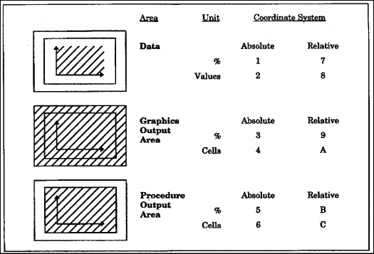
Coordinate Systems

Slide 131
Annotate coordinates
Coordinates specify where to put graphics elements
These variables can contain coordinate values:
  X, Y, and Z
    used for numeric coordinates.
    use Z to annotate graphics output from the G3D procedure only.
  XC and YC
    used for character coordinates.
  GROUP, MIDPOINT, and SUBGROUP
    used when you annotate output from the GCHART procedure
    use these variables to specify coordinates for horizontal or vertical bar charts.
Coordinates are interpreted in terms of a coordinate system in order to identify a precise location in the graphics output.

Slide 132
Annotate Macros
Make it easier to create annotate records
Activate by issuing %annomac
SAS LOG
1 %annomac
*** ANNOTATE macros are now available ***
For further information on ANNOTATE macros, enter,
%HELPANO(macroname), (for specific macros)
%HELPANO(ALL), (for information on all macros)
or %HELPANO (for a list of macro names)

Slide 133
Annotate Macros 1/4
%TXT2CNTL;
  assign values of (XLSTT,YLSTT) to (XLAST,YLAST)
%POLY(x, y, color, style, line);
  begin drawing a polygon
%POLYCONT(x, y, color);
  continue drawing a polygon
%CNTL2TXT;
  copy (XLAST,YLAST) to (XLSTT,YLSTT)
%DCLANNO;
  declare all variables
%BAR(x1, y1, x2, y2, color, line, style);
  draw a bar

Slide 134
Annotate Macros 2/4
%CIRCLE(x, y, size, color);
  draw a circle
%FRAME(color, line, size, style);
  draw a frame
%DRAW2TXT(color, line, size);
  draw a line from (XLAST,YLAST) to (XLSTT,YLSTT)
%DRAW(x, y, color, line, size);
  draw a line from previous point
%LINE(x1, y1, x2, y2, color, line, size);
  draw a line
%SLICE(x, y, angle, rotate, size, color, style, line);
  draw a pie slice or arc

Slide 135
Annotate Macros 3/4
%RECT(x 1,y 1,x 2,y 2, color, line, size);
  draw a rectangle
%LABEL(x, y, text, color, angle, rotate, size, style, position);
  draw text
%SWAP;
  exchange the values of (XLAST,YLAST) and (XLSTT,YLSTT)
%PIEXY(angle, size);
  move to a point near a pie slice
%MOVE(x, y);
  move to a point without drawing

Slide 136
Annotate Macros 4/4
%PUSH;
  put values into a stack
%POP;
  retrieve values from a stack
%SCALET(ptx, pty, x0, y0, x1, y1, x0, vy0, vx1, vy1);
  scale and move input
%SCALE(ptx, pty, x0, y0, x1, y1, x0, vy0, vx1, vy1);
  scale input
%SYSTEM(xsys, ysys, hsys);
  set the coordinate system for the observation
%SEQUENCE(when);
  set when to draw an observation
%COMMENT(text);
  write a comment to the data set

Slide 137
Annotate Examples
Look at this directory to find examples
  SAS 8.2
    C:\Program Files\SAS Institute\SAS\V8\graph\sample
  SAS 9.1
    C:\Program Files\SAS\SAS 9.1\graph\sample

Slide 138
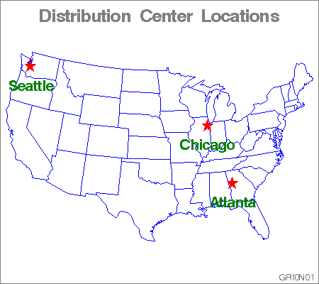
GR10N01-Labelling Cities on a Map

Slide 139
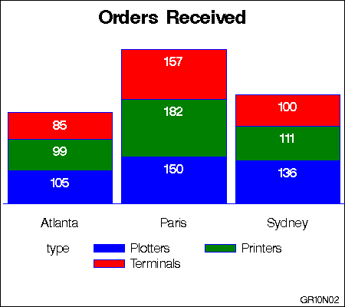
GR10N02-Labelling Subgroups in a Vertical Bar Chart

Slide 140
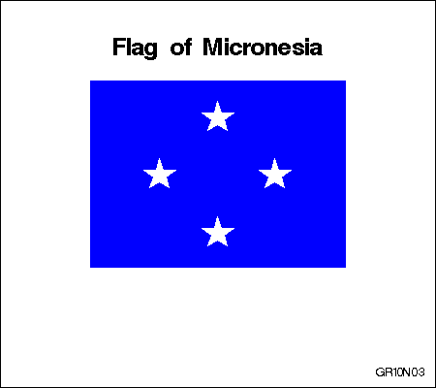
GR10N03-Drawing a Circle of Stars

Slide 141
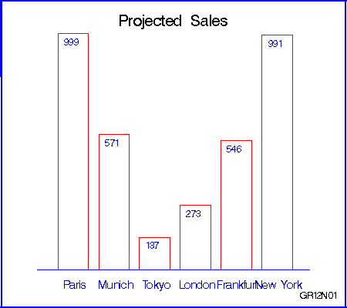
GR12N01-Scaling Data-Dependent Output

Slide 142
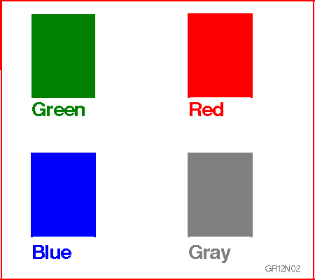
GR12N02-Storing Annotate Graphics

Slide 143
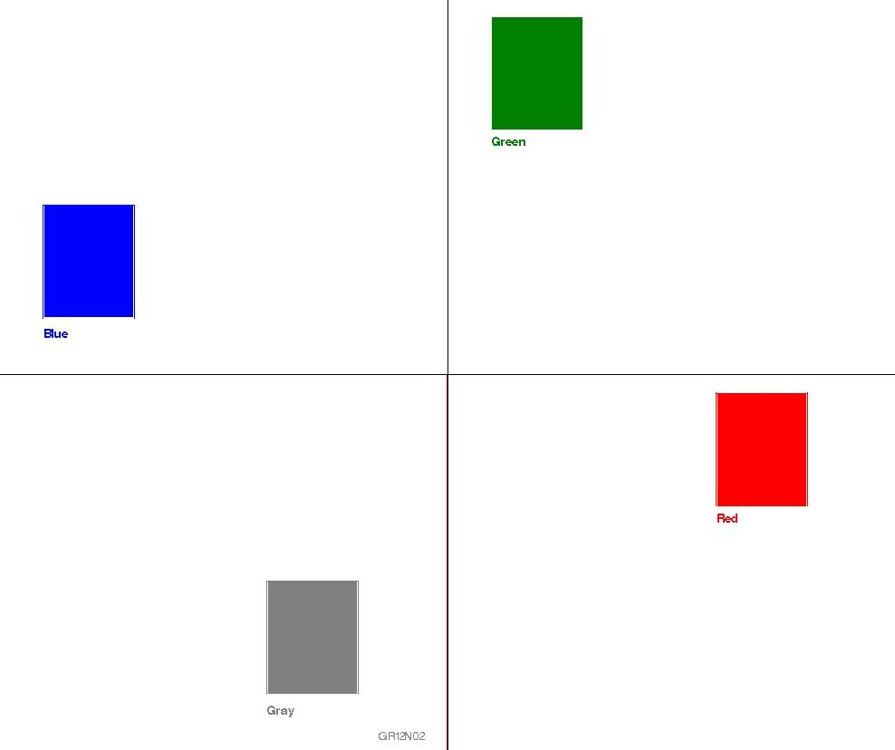
GR12N03-Using NAME= to Produce Multiple Graphs

Slide 144
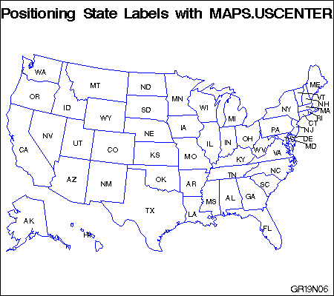
GR19N06-Labeling the States on a U.S. Map

Slide 145
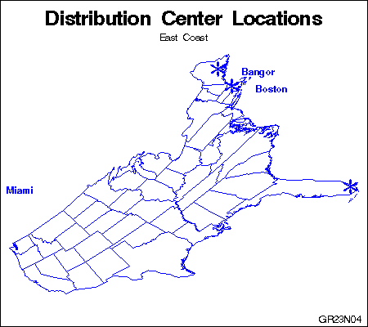
GR23N04-Projecting an Annotate Data Set

Slide 146
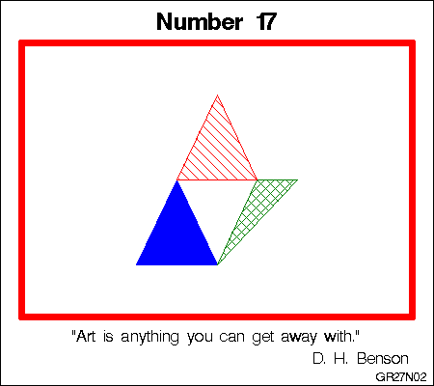
GR27N02-Displaying Annotate Graphics

Slide 147
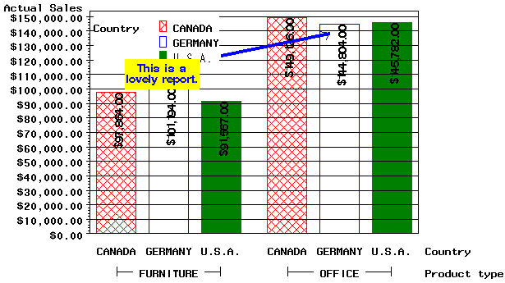
Annotate example 1.sas

Slide 148
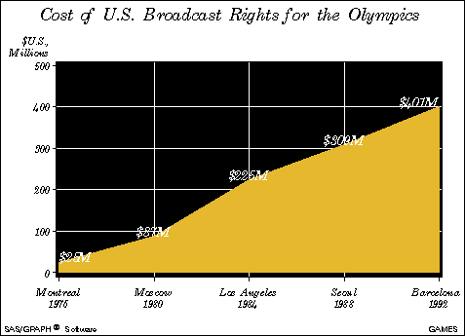
Annotate example 2.sas

Slide 149
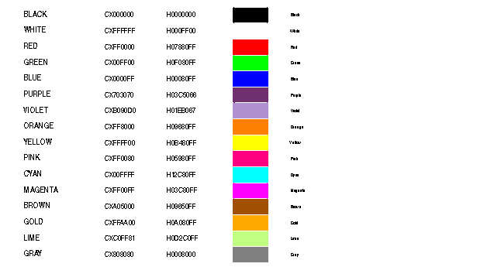
Annotate example 3.sas

Slide 150
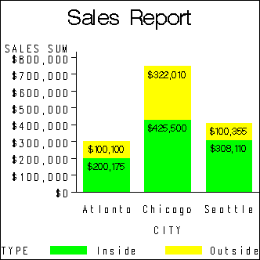
Sample362.sas

Slide 151
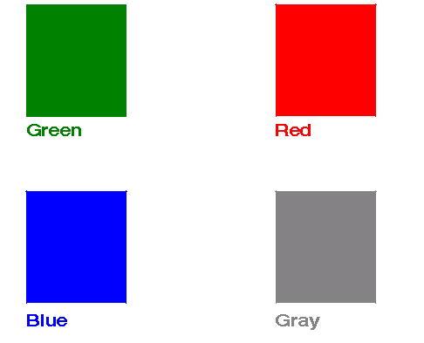
Sample1054.sas

Slide 152
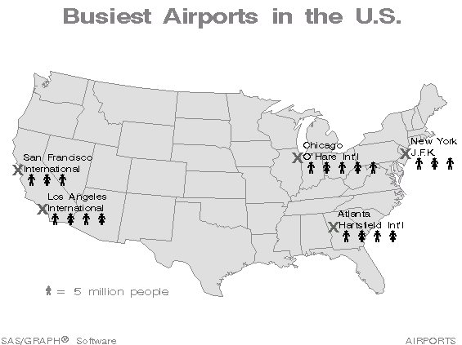
Sample366.sas

Slide 153
Annotate documentation
SAS 8.2 & SAS 9 online documentation
Various SUGI papers
“Annotate – simply the basics” by Art Carpenter

Slide 154
DSGI

Slide 155
DSGI
Why DSGI?
  Data Step Graphics Interface
What can it do
  Make custom graphics
  Replay existing graphics
    Put several graphs on a single graph
    Overlay or insert graphics into other graphics
  Annotate existing graphics

Slide 156
Steps to create simple graphics with DSGI
Initialize DSGI using GINIT()
  loads graphics sub-library
  opens a workstation
  activates a workstation
Open a graphics segment using GRAPH('CLEAR', . . .)
  means that graphics primitives can be submitted.

Slide 157
Further steps …
Generate graphics elements using GDRAW()
  DSGI can generate arcs, bars, ellipses, elliptical arcs, lines, markers, pie slices, polygons (fill areas), and text. GDRAW functions can only be submitted when a graphics segment is open.
Close the graphics segment using GRAPH(‘UPDATE’,…)
  closes graphics segment and outputs graph
End DSGI using GTERM()
  Deactivates and closes the workstation, and closes graphics sub-library. It frees any memory allocated by DSGI.

Slide 158
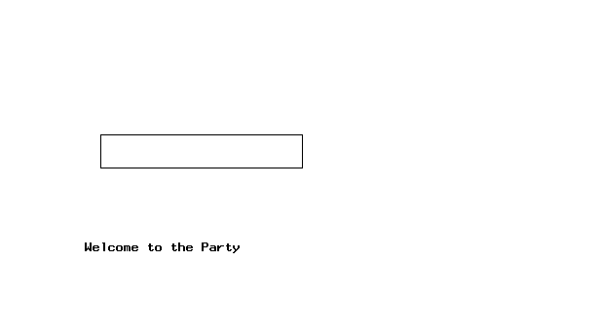
DSGI example 1 – code next slide

Slide 159
DSGI example 1.sas
goptions reset=all ;
data dsgi ;
rc=ginit() ;
rc=graph('clear','text') ;
rc=gdraw('text',25,25,'Welcome to the Party');
rc=gdraw('bar',30,50,90,60) ;
rc=graph('update') ;
rc=gterm() ;
run ;

Slide 160
What can be generated with DSGI
arcs
bars
ellipses
elliptical arcs
lines
markers
pie slices
polygons (filled areas)
text

Slide 161
Calling DSGI routines
1) CALL GASK(operator, arguments);
2) return-code-variable=function-name (operator, arguments);
  Arguments … are the additional required variables or values for the routine or function.
  return-code-variable … is an arbitrary name and can be any numeric variable name. It will hold the return code upon execution of the function.
  function-name … is the DSGI command you want to execute and must be one of the following: GDRAW, GINIT, GPRINT, GRAPH, GSET, or GTERM.
  Operator … is a character string that names the function you either want to submit or for which you want the current settings. When used with functions, operator can take different values depending on function-name.

Slide 162
Operating states
The operating states defined by DSGI are
  GKCL facility closed, the initial state of DSGI. No graphical resources have been allocated.
  GKOP facility open. When DSGI is open, you may check the settings of the attributes.
  SGOP segment open. At this point, graphics output primitives may be generated.
  WSAC workstation active. When the workstation is active, it can receive DSGI statements.
  WSOP workstation open. In this implementation, the graphics catalog, either the default or the one specified through the GSET('CATALOG', . . . ) command, is opened or created.
Functions can only be issued when certain states are active

Slide 163

DSGI example 2.sas – code next slide

Slide 164
DSGI example 2.sas
goptions dev=win;
data _null_ ;
rc=ginit();
rc=graph('clear','text');
rc=gset('colrep',1,'blue');
rc=gset('colrep',2,'red');
rc=gset('texcolor',1);
rc=gset('texfont','swissb');
rc=gset('texheight',6);
rc=gdraw('text',25,75,'Created with DSGI');
rc=gset('filcolor',2);
rc=gset('filtype','solid');
rc=gdraw('pie',50,50,10,0,270);
rc=graph('update');
rc=gterm();
run;

Slide 165

DSGI example 3.sas code next slide

Slide 166
DSGI example 3.sas
goptions dev=win border nocell nocharacters hpos=80 vpos=62;
%Macro Clock(x,y,rad,xadj,yadj,hr,min);
Rc=Gdraw('ARC',&X,&Y,&RAD,0,360);
Mangle=-((&min-15)*6)* .0174532925199433;
Hangle=-((&hr-3)*30+&min/2)*.0174532925199433;
Mx=&x+cos(mangle)*.75*&rad*&xadj;
My=&y+sin(mangle)*.75*&rad*&yadj;
Hx=&x+cos(hangle)*.45*&rad*&xadj;
Hy=&y+sin(hangle)*.45*&rad*&yadj;
Rc=Gdraw('Line',2,&x,mx,&y,my);
Rc=Gdraw('Line',2,&x,hx,&y,hy);
%mend clock;
data _null_;
length title $ 15;
rc=ginit();
rc=graph('Clear','Clock');
rc=Gset('Linwidth',3);
Rc=Gset('Texheight',3);
Rc=Gset('Texalign','Center','Half');
Rc=Gset('Texfont','Centx');
Call Gask('Aspect',Aspect,RC);
If (Aspect<1) then do;
Xadjust=Aspect;
Yadjust=1;
End;
Else Do;
Xadjust=1;
Yadjust=1/Aspect;
End;
Radius=20;
Do i=1 to 12;
Angle=-((i-3)*30) * .0174532925199433;
X=50+cos(angle)*.83*radius*xadjust;
Y=50+sin(angle)*.83*radius*yadjust;
Rc=Gdraw('Text',x,y,put(i,roman4.));
End;
Timenow=Time();
Hours=Hour(Timenow);
Hours=Mod(Hours,12);
Minutes=Minute(Timenow);
%Clock(50,50,radius,xadjust,yadjust,hours,minutes);
Rc=Gset('Texheight',8);
Rc=Graph('Update');
Rc=Gterm();
Run;

Slide 167
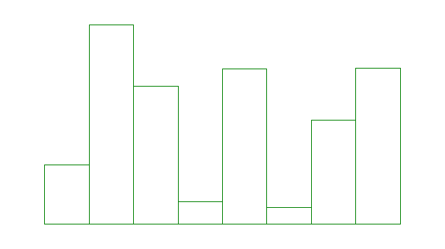
DSGI example 4.sas code next slide

Slide 168
DSGI example 4.sas
proc summary data=sashelp.shoes nway ;
class product ;
var sales ;
output out=shoes sum= ;
run ;
proc sql noprint ;
select max(sales) into :max from shoes ;
%put max=&max;
data _null_ ;
retain x1 x2 y1 y2 ;
set shoes nobs=obs end=end ;
if _n_=1 then
do ;
rc=ginit() ;
rc=graph('clear','mygraph') ;
call gask
('window',1,x1,y1,x2,y2,rc) ;
end ;
x=x2/(obs+2) ;
y=(y2-20)*(sales/&max)+10 ;
if y<20 then
put _all_;
rc=gset('colrep',1,'green') ;
rc=gset('filcolor',1) ;
rc=gset('filtype','hollow') ;
rc=gdraw('bar',x*_n_,10,x*(_n_+1),y) ;
if end then
do ;
rc=graph('update') ;
rc=gterm() ;
end ;
run ;

Slide 169
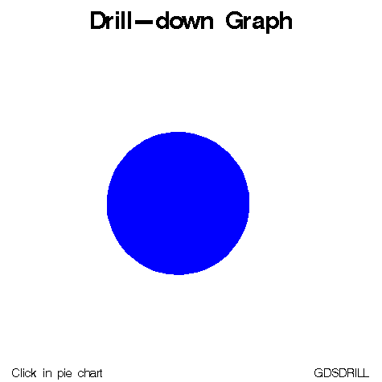
Sample1083.sas

Slide 170
DSGI vs. Annotate
Why use DSGI
  Can create graphics
  Can be used from data step
  Annotate only works from procedures supporting it
Why use Annotate
  Can be used stand-alone
  Can be used with many graphic procedures
  DSGI can’t be used with procedures

Slide 171
Goptions

Slide 172
Goptions
Use Proc Goptions to get a list of these, e.g.
  proc goptions ; run ;
  proc goptions short ; run ;
Proc goptions items ; run ;
  Items include:
    AXIS, FOOTNOTE, LEGEND, OPTION=graphics-option, PATTERN, SYMBOL, TITLE

Slide 173
Useful goptions
The following slides are a list of particularly useful graphics options
It is not a complete list – there are others

Slide 174
Display
Options display ;
  display graphs as they are created
Options nodisplay ;
  Prevents display of graphs
  Useful for writing graphics to a catalog, without displaying on screen

Slide 175
Targetdevice=
display output as it would appear on another device
e.g. to see how your output would look on an HP laserjet in 300dpi …
  Goptions targetdevice=hplj300 ;

Slide 176
Reset=
Reset=all
  reset all graphic statements & options
Reset a particular group of graphic options
  Reset=goption
  reset=global
  reset=axis
  reset=(axis title)

Slide 177
Rotate
Rotate
  Rotate output 90 degrees from default
rotate=portrait
rotate=landscape

Slide 178
Colors=
Defines sequence of colours to use when making graphs
Colours=none
  Tells SAS to ignore default colour list and only use those specified
E.g.
  Goptions colours=(red green blue) ;

Slide 179
Cback=colour
for background colour
E.g. goptions cback=gray ;

Slide 180
Controlling attributes of BY groups
cby=colour
fby=font
hby=height
E.g.
  Goptions cby=red fby=titalic hby=2cm ;

Slide 181
Setting default colours
Cpattern
  Colour for pattern
Csymbol
  Colour for symbol
Ctext
  Text colour
Ctitle
  Title colour

Slide 182
Other default text attributes
ftext=
  Default font for text
htext=
  Default height of text
E.g.
  Goptions ftext=simplex htext=5pct ;

Slide 183
Interpol=
default interpolation method
E.g.
  Goptions interpol=spline ;
See later section for more information

Slide 184
Border
for framing display
Goptions border ;
Goptions noborder ;

Slide 185
Define number of columns & rows
Landscape
  Lcols=
  lrows=
Portrait
  Pcols=
  prows=

Slide 186
Setting the size of paper
Goptions Papersize=a4 ;
  sets papersize to A4
Goptions Papersize=letter ;
Goptions Papersize=legal ;

Slide 187
Sets measure to use for heights
Gunit=
  CELLS character cells
  CM centimeters
  IN inches
  PCT percentage of the graphics output area
  PT points (there are approximately 72 points in an inch)
Relative measures: PCT
In-between: CELLS (depends on cell size)
Absolute measures: CM, IN, PT

Slide 188
Set origin of display
specify lower left corner of display area
  Horigin=
  vorigin=

Slide 189
Number of columns & rows in output area
hpos=
vpos=

Slide 190
Horizontal & verttical size of output area
Hsize=
vsize=
Hsize = XMAX - LEFTMARGIN – RIGHTMARGIN
size of display area
  Xmax=
  ymax=
width of display area in pixels
  xpixels=
  ypixels=

Slide 191
How do these affects graphs we create?
  HPOS/VPOS
  HORIGIN/VORIGIN
  HSIZE/VSIZE
  XMAX/YMAX
  XPIXELS/YPIXELS

Slide 192
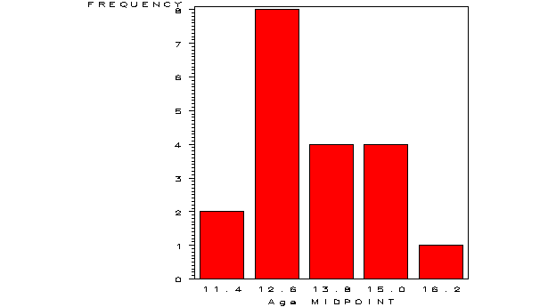
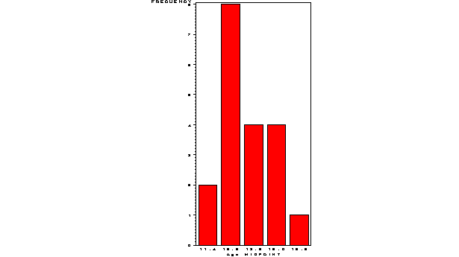
vpos/hpos=50 vs. 100
hpos=50 vpos=50
hpos=100 vpos=100

Slide 193
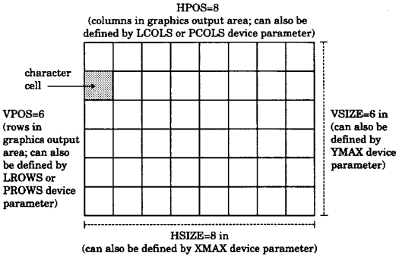
Values that define the graphics output area

Slide 194
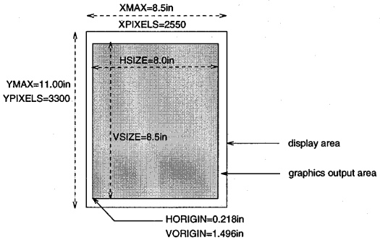
Interaction between parameters

Slide 195
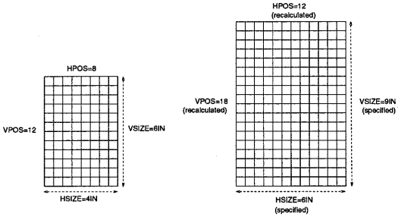
Interaction between parameters

Slide 196
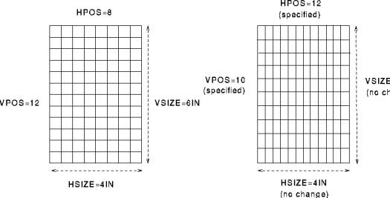
Interaction between parameters

Slide 197
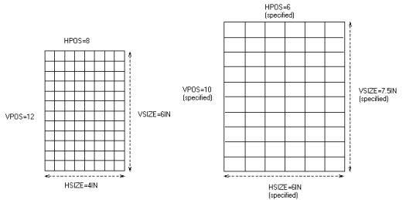
Interaction between parameters

Slide 198
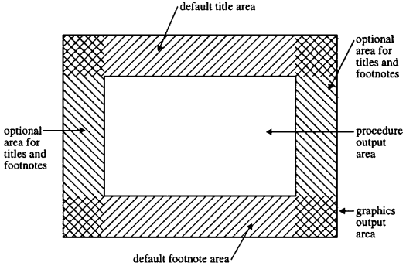
Space for graphics elements is allocated in order
1
3
2

Slide 199
Fonts

Slide 200
What fonts are defined 1/2
Look at sashelp.fonts
  e.g. swiss, duplex, titalic, …
Examining an existing font
  proc gfont name=greek
  nobuild
  height=3.7
  romcol=red
  romfont=swissl
  romht=2.7
  showroman;
  run;
  quit;

Slide 201
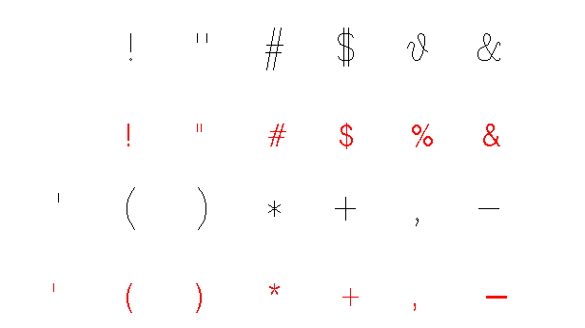
What fonts are defined 2/2

Slide 202
Hardware vs. Software fonts
Hardware fonts belong to the device being used
  Can be selected as follows, font=HWxxxnnn
    HW signifies a hardware font
    Xxx is the last 2 or 3 characters of module from device driver
    Nnn is the chartype number of the font required
Software fonts are defined within SAS and represented on a device graphically

Slide 203
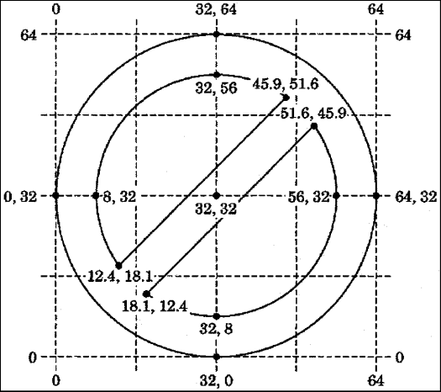
Custom Fonts
Can create fonts using proc gfont
takes dataset with coordinates as input

Slide 204
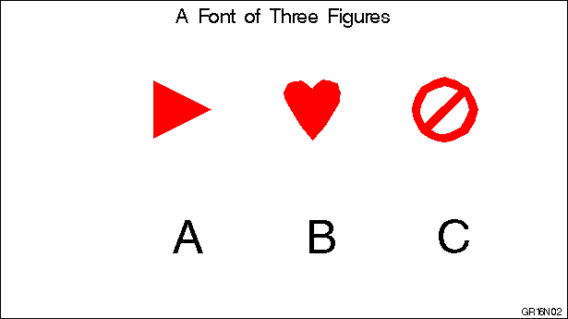
Gfont example 1.sas

Slide 205
Gfont example 1.sas
libname gfont0 'c:\';
goptions reset=global gunit=pct border cback=white
colors=(black blue green red)
ftext=swiss htitle=6 htext=3;
data figures;
input char $ ptype $ x y segment lp $;
datalines;
A W 0 64 0 P /* triangle pointing right */
A V 4 4 1 P
A V 60 32 1 P
A V 4 60 1 P
A V 4 4 1 P
B W 0 64 0 P /* heart */
B V 32 2 1 P
B V 44 17 1 P
B V 58 40 1 P
B C 46 47 1 P
B V 56 58 1 P
B C 46 47 1 P
B V 32 52 1 P
B C 18 47 1 P
B V 8 58 1 P
B C 18 47 1 P
B V 6 40 1 P
B V 20 17 1 P
B V 32 2 1 P
C W 0 64 0 P /* circle & slash */
C V 32 64 1 P
C C 32 32 1 P
C V 64 32 1 P
C C 32 32 1 P
C V 32 0 1 P
C C 32 32 1 P
C V 0 32 1 P
C C 32 32 1 P
C V 32 64 1 P
C V . . 1 P
C V 12.4 18.1 1 P
C C 32 32 1 P
C V 8 32 1 P
C C 32 32 1 P
C V 32 56 1 P
C C 32 32 1 P
C V 45.9 51.6 1 P
C V . . 1 P
C V 51.6 45.9 1 P
C C 32 32 1 P
C V 56 32 1 P
C C 32 32 1 P
C V 32 8 1 P
C C 32 32 1 P
C V 18.1 12.4 1 P
;
Run ;

Slide 206
Gfont example 1.sas
title 'A Font of Three Figures';
footnote j=r 'GR16N02 ';
proc gfont data=figures
name=figures
filled
height=.75in
ctext=red
showroman
romht=.5in
resol=2;
run;
quit;

Slide 207

Titles, Notes & Footnotes
Use fonts with the FONT= keyword
Can use hex values representing characters within a font
  e.g. Title font=zapf ’18’x ;

Slide 208
TrueType fonts
With ODS support now you can usually access truetype fonts directly
  Title f=“times new roman” “Sales Report” ;
On systems without truetype (e.g. UNIX) you can install and use Freetype fonts

Slide 209
Proc Gdevice

Slide 210
Useful parameters in Proc Gdevice
Many goptions can also be used in Proc Gdevice as parameters
additional parameters are available, e.g.
  Charrec to define hardware fonts
    charrec=(1, 100, 75, 'helvetica', 'y')
  Cmap to define colors to map from one thing to another, e.g. canary=yellow
    Allows creation of custom colours
  check the documentation for more

Slide 211
Device drivers
Made up of
  a catalog entry in SASHELP.DEVICES
  An external module
  e.g.
  BMP driver
    Entry … Sashelp.devices.bmp.dev
    Module … sasgddmx

Slide 212
Interrogating defined devices
List all devices
  Run proc gdevice in window mode
  Run proc gdevice in program mode
    Proc gdevice nofs ;
    list _all_ ;
    run ;
Partial Output
NAME DESCRIPTION DATE
ACTIVEX ActiveX enabled GIF Driver 09/06/2000
APLPLUS Apple Laserwriter Plus (PostScript) 09/06/2000
APPLELW Apple Laserwriter (PostScript) 09/06/2000
APPLELWM Apple Laserwriter A4 paper 09/06/2000
BJC800 Canon Color Bubble Jet 800--LQ mode 09/06/2000
BMP BMP File Format--256 colors 09/06/2000
BMP20 BMP 2.0 File Format--256 colors 09/06/2000
CAPSL3A4 Canon Laser Beam(CaPSL3) - A4 size 09/06/2000
CAPSL3B5 Canon Laser Beam(CaPSL3) - B5 size 09/06/2000
CAPSL3EX Canon Laser Beam(CaPSL3) - Executive siz 09/06/2000

Slide 213
Interrogating defined devices
Examine a device
    Proc gdevice nofs ;
    list cgm ;
    run ;

Slide 214
GDEVICE procedure
Listing from SASHELP.DEVICES - Entry CGM
Orig Driver: CGM Module: SASGDCGM Model: 3910
Description: CGM generator--binary output Type: EXPORT
*** Institute-supplied ***
Lrows: 0 Xmax: 8.500 IN Hsize: 0.000 IN Xpixels: 25320
Lcols: 0 Ymax: 11.000 IN Vsize: 0.000 IN Ypixels: 32767
Prows: 100 Horigin: 0.000 IN
Pcols: 85 Vorigin: 0.000 IN
Aspect: 0.000 Rotate:
Driver query: Queued messages: N
Paperfeed: 0.000 IN
OPTIONS
Erase: Autofeed: Chartype: 1
Swap: Cell: Maxcolors: 256
Autocopy: Characters: Repaint: 0
Handshake: NONE Circlearc: Gcopies: 0
Dash: Gsize: 0
Prompt - startup: X Fill: Speed: 0
end graph: X Piefill: Fillinc: 0
mount pen: Polyfill: Maxpoly: 0
chg paper: Symbol: Lfactor: 0
Pensort: N
Promptchars: '000A010D05000000'X
Devopts: 'F512304220000000'X
Cback: WHITE
Color list:
BLACK
[more output not shown]

Slide 215
Proc Gdevice has 13 windows
Directory Window
Detail Window
Parameters Window
Gcolors Window
Chartype Window
Colormap Window
Metagraphics Window
Gprolog Window
Gepilog Window
Gstart Window
Gend Window
Host File Options Window
Host Commands Window
Let’s have a look at PROC GDEVICE

Slide 216
Creating new drivers
SAS looks for device drivers in SASHELP.DEVICES
If librefs Gdevice0 – Gdevice9 are allocated then they are searched before SASHELP.DEVICES
Could use the following code to create a new driver by modifying an existing device driver
  libname gdevice0 ‘c:\’;
  proc gdevice nofs catalog=gdevice0.devices;
  copy pscolor from=sashelp.devices
  newname=mypscol;
  modify mypscol
  description='PSCOLOR with new colors list’
  colors=(black blue green red gray cyan);
  quit;
  goptions target=mypscol;
  proc gtestit pic=1;
  run;

Slide 217
Using windows printer drivers
Use a windows device to send to your default windows printer
  Winprtc … colour
  Winprtg … gray scale
  Winprtm … mono – black & white
  Winplot … plotter output

Slide 218
Changing parameters
Via driver
  Can modify the actual device driver or create a new one
Via goptions
  Many device parameters can be overridden using GOPTIONS
    e.g. colors=, hsize=, vsize=
Via statement options
  Some device parms can be overridden like this
    Title color=blue font=swissb ‘test’ ;

Slide 219
Colours

Slide 220
Different colour schemes
RGB (red green blue)
  CXrrggbb
    Rr … red component of color
    Gg … green component of color
    Bb … blue component of color
  Black is CX000000, Green is CX00FF00

Slide 221
Different colour schemes
HLS (hue lightness saturation)
  Hhhhllss
    Hhh … hue component of color
    ll … lightness component
    Ss … saturation component

Slide 222
Different colour schemes
Gray scale
  GRAYll
    ll … lightness of gray, FF is white, 00 is black

Slide 223
Different colour schemes
Predefined SAS color names
  Prefix+hue+hue+hue
  Hues are colors like red, pink, green, blue, etc.
  Prefixes are pale, dark, vivid, very light, etc.

Slide 224
Colours that look strange
Browser-safe colours
  Colours that always look as they should in web browsers
  See http://www.primeshop.com/html/216colrs.htm
SAS colour oddities
  Light pink is darker than pink

Slide 225
Statements
Axis, Symbol, Legend & Pattern

Slide 226
Advanced SYMBOL
SYMBOL<1...99>
<COLOR=symbol-color>
<MODE=EXCLUDE | INCLUDE>
<REPEAT=number-of-times>
<STEP=distance<units>>
<appearance-option(s)>
<interpolation-option>;

Slide 227
appearance-options can be one or more of these
BWIDTH=box-width
CI=line-color
CO=color
CV=value-color
FONT=font
HEIGHT=symbol-height<units>
LINE=line-type
POINTLABEL<=(label-description(s)) | NONE>
VALUE=special-symbol | text-string | NONE
WIDTH=thickness-factor

Slide 228
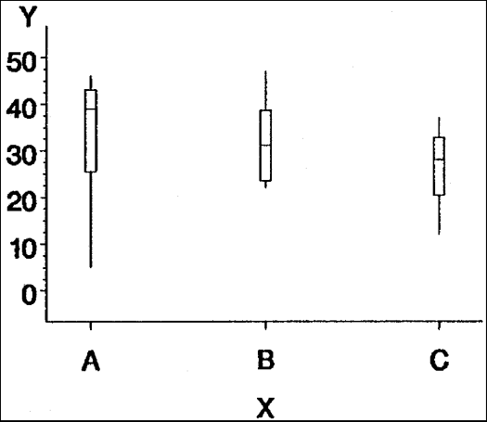
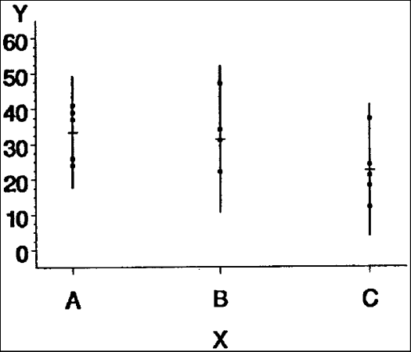
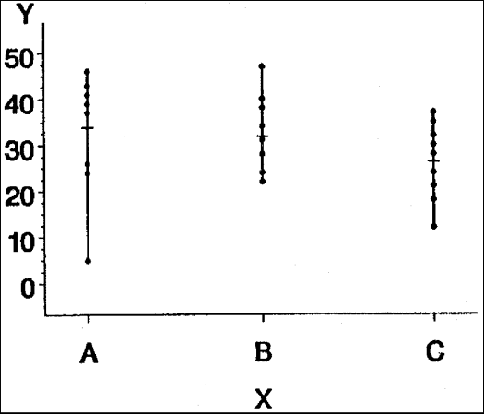
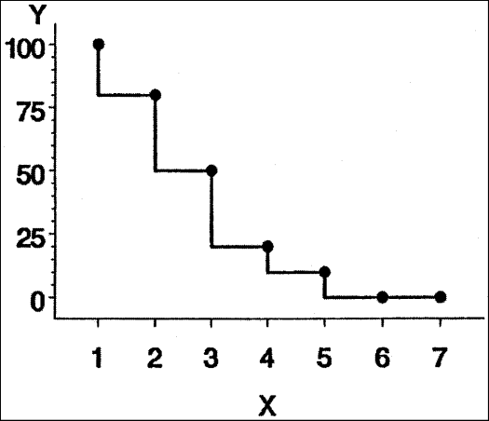
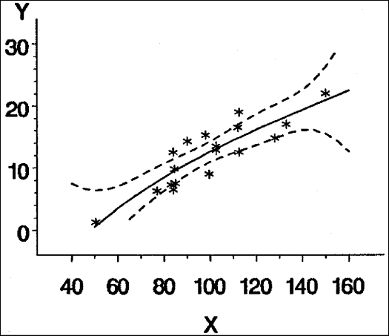
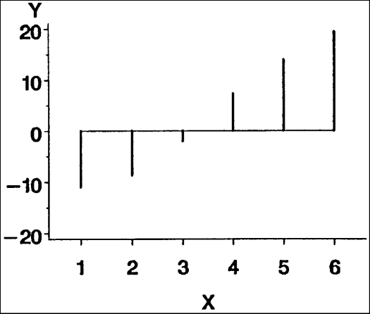
Interpolation-option can be one of these
general methods
  INTERPOL=JOIN
  INTERPOL=map/plot-pattern
  INTERPOL=NEEDLE
  INTERPOL=NONE
  INTERPOL=STEP<placement><J><S>
high-low interpolation methods
  INTERPOL=BOX<option(s)><00...25>
  INTERPOL=HILO<C><option(s)>
  INTERPOL=STD<1 | 2 | 3><variance><option(s)>
regression interpolation methods
  INTERPOL=R<type><0><CLM | CLI<50...99>>
spline interpolation methods
  INTERPOL=L<degree><P><S>
  INTERPOL=SM<nn><P><S>
  INTERPOL=SPLINE<P><S>

Slide 229
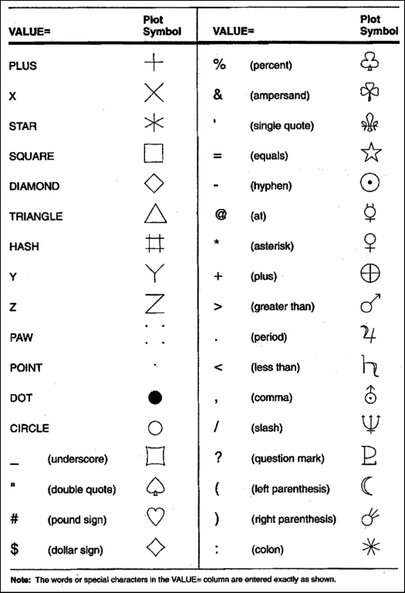
Special Symbols for Plotting Data Points
You can use special symbols
or use other fonts and characters from them

Slide 230
Advanced LEGEND

Slide 231
Legend
LEGEND<1...99><options>;
  option(s) can be one or more options from any or all of the following categories:
appearance options
  ACROSS=number-of-columns
  CBLOCK=block-color
  CBORDER=frame-color
  CFRAME=background-color
  CSHADOW=shadow-color
  DOWN=number-of-rows
  FRAMEFWIDTH=thickness-factor
  SHAPE=BAR(width,height) <units> | LINE(length) <units> | SYMBOL(width,height) <units>

Slide 232
Legend
position-options
  MODE=PROTECT | RESERVE | SHARE
  OFFSET=(<x ><,y >)<units > | (<x <units >><,y <units >>)
  ORIGIN=(<x ><,y >)<units > | (<x <units >><,y <units >>)
  POSITION=(<BOTTOM | MIDDLE | TOP> <LEFT | CENTER | RIGHT> <INSIDE | OUTSIDE>)
text-options
  LABEL=(text-argument(s)) | NONE
  ORDER=(value-list)
  VALUE=(text-argument(s)) | NONE

Slide 233
Advanced PATTERN
PATTERN<1...99>
<COLOR=pattern-color>
<REPEAT=number-of-times>
<VALUE=bar/block-pattern
| map/plot-pattern
| pie/star-pattern
| hardware-pattern>;
bar/block-pattern can be one of these: EMPTY, SOLID, style <density>
map/plot-pattern can be one of these: MEMPTY, MSOLID, Mdensity <style <angle>>
pie/star-pattern can be one of these: PEMPTY, PSOLID, Pdensity <style <angle>>
hardware-pattern has this form: HWxxxnnn

Slide 234
Patterns

Slide 235
Advanced AXIS
AXIS<1...99><options>;
  option(s) can be one or more options from any or all of the following categories:
axis scale options:
  LOGBASE=base | E | PI
  LOGSTYLE=EXPAND | POWER
  ORDER=(value-list)
appearance options:
  COLOR=axis-color
  LENGTH=axis-length <units >
  NOBRACKETS
  NOPLANE
  OFFSET=(<n1 ><,n2 >)<units > | (<n1<units>><,n2<units >>)
  ORIGIN=<(x><,y >)<units> | (<x<units >><,y<units>>)
  STYLE=line-type
  WIDTH=thickness-factor

Slide 236
Advanced AXIS
tick mark options:
  MAJOR=(tick-mark-suboption(s) ) | NONE
  MINOR=(tick-mark-suboption(s) ) | NONE
text options:
  LABEL=(text-argument(s) ) | NONE
  REFLABEL=(text-argument(s) ) | NONE
  SPLIT="split-char”
  VALUE=(text-argument(s) ) | NONE

Slide 237
New features in SAS 9
3 procedures, several options, statements and so on…

Slide 238
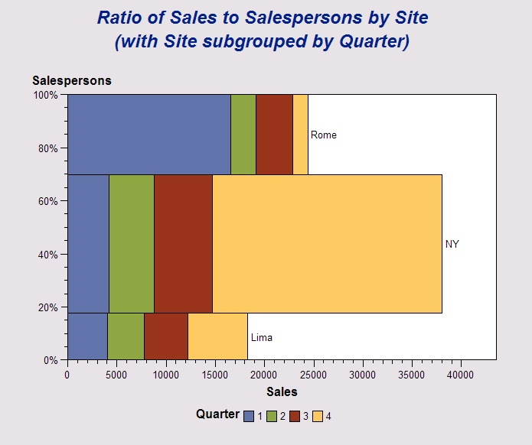
Proc Gareabar – gareabar.sas

Slide 239
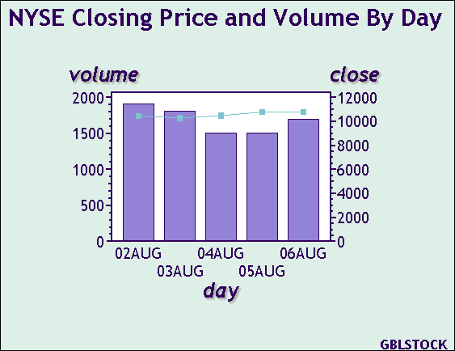
Proc Gbarline – gbarline.sas

Slide 240
Proc MapImport
Lets you import ESRI shapre files into SAS to use with SAS mapping procedures.

Slide 241
ODS & Graph

Slide 242
Graphs without ODS
Saving to a file
  define fileref to point to file
    File on LAN, using filename
    File on web site, using URL or FTP engine
  use goptions gsfname=fileref
Getting top quality
  combination of Goptions & device driver

Slide 243

Example graph without ODS
230 goptions reset=all ;
231 filename g 'c:\test.png' ;
232 goptions device=png gsfname=g ;
NOTE: PROCEDURE GDEVICE used:
real time 10:30.42
cpu time 0.01 seconds
233 proc gchart data=sashelp.class ;
234 hbar age ;
235 run ;
NOTE: RECORDS WRITTEN TO c:\test.png
235! quit ;
NOTE: There were 19 observations read from the data set SASHELP.CLASS.
NOTE: PROCEDURE GCHART used:
real time 0.08 seconds
cpu time 0.04 seconds

Slide 244
Graphs with ODS
Which destinations support graphics?
  Main ones such as RTF, PDF, HTML
Are all devices supported?
  No, just JPEG, GIF, PNG, and some others
Best ODS/device driver combination
  most locations provide very good quality
Getting top quality
  select the best combination

Slide 245
Using ODS with SAS/Graph
Using ODS with SAS/GRAPH has numerous advantages over generating Web output with the HTML or WEBFRAME device drivers. With ODS, you can:
  name the body file(s) for storing the ODS output determine whether titles and footnotes are written as part of the graphs or as part of the HTML files

Slide 246
HTML & Webframe drivers
Let’s run the following code, then examine output
goptions reset=all device=html ;
proc gchart data=sashelp.class ;
vbar sex ;
run ; quit ;
goptions reset=all device=webframe ;
proc gchart data=sashelp.class ;
vbar sex ;
run ; quit ;

Slide 247
Using ODS with SAS/Graph ...
combine graphics and non-graphics output in your Web page
  Produces table & graph, but browser can’t find graph
    ods html file='c:\test.html' ;
    proc print data=sashelp.class ;
    run ;
    proc gchart data=sashelp.class ;
    vbar sex ;
    run ; quit ;
    ods html close ;

Slide 248
Fixing missing graph problem
Add gpath= to tell ODS where to store graph
    ods html file='c:\test.html' gpath='c:\' ;
    proc print data=sashelp.class ;
    run ;
    proc gchart data=sashelp.class ;
    vbar sex ;
    run ; quit ;
    ods html close ;

Slide 249
Generate a Table of Contents to link to the output
Producing several graphs will write them all to the same location and show one after the other from html
Add contents= to ODS statement
ods html file='c:\test.html‘
contents='c:\cont.html‘
gpath='c:\' ;

Slide 250
Generate a Table of Pages to link to the output
Can make a table of pages, providing direct links to each page
Add page= to ODS statement
ods html file='c:\test.html'
page='c:\pages.html‘
contents='c:\cont.html‘
gpath='c:\' ;

Slide 251
Use HTML frames to display the Table of Contents or Table of Pages
ods html file='c:\test.html'
page='c:\pages.html'
contents='c:\cont.html'
frame='c:\frame.html'
gpath='c:\' ;
Note: you can’t browse frames from within SAS, but must use another browser

Slide 252
Create drill-down graphs
Create data with references to drill down graphs
References are defined in html= parameters of various procedures such as Gchart
Procedure creates HTML to link to other pages

Slide 253
To use ODS with SAS/Graph
At a minimum, to use ODS with SAS/GRAPH, you must do all of the following:
  use a GOPTIONS statement to specify a device driver
  use the ODS destination statement to specify the ODS options you want to use
    E.g. ods html file=‘c:\test.html’ ;
  run a graphics procedure
  close the HTML destination by specifying ODS HTML CLOSE.

Slide 254
Create Java applets or ActiveX controls
An easy way to create powerful & flexible graphs easily
Java graphs work on most platforms
Activex graphs work on windows platforms
Note: The JAVA and ACTIVEX device drivers can only be used with the GCHART, GCONTOUR, GMAP, GPLOT, and G3D procedures.

Slide 255
JAVA graphs
Run the following for demo
ods html file='c:\test.html' ;
goptions reset=all device=java ;
proc gchart data=sashelp.class ;
vbar sex ;
run ; quit ;
ods html close ;

Slide 256
Activex graphs
Run the following for demo
ods html file='c:\test.html' ;
goptions reset=all device=activex ;
proc gchart data=sashelp.class ;
vbar sex ;
run ; quit ;
ods html close ;

Slide 257
Supporting documentation
support.sas.com/techsup/tnote/tnote_graph.html
  TS-659: Exporting SAS/Graph Output to PDF Files
  TS-674: An Introduction to Exporting SAS/Graph Output to Microsoft Office
  TS-688: Specifying Colors Using Hex Values

Slide 258
Understanding Graphics and ODS
Getting the best quality output
Based on a paper by Dawn Schrader, SAS/Graph Technical Support

Slide 259
Storage methods
Vector formats
Raster formats
circle{center=(5,5),
radius=4}
wwwwwwwwww
wwbbbbbbww
wbbwwwwbbw

Slide 260
Resolution of raster formats
Low
High

Slide 261
Fonts
Software Fonts
Hardware Fonts
Any format
Any operating system
e.g. simplex
Varies by format
e.g. Arial

Slide 262
Static Web Graphs
JPEG - Joint Photographic Experts Group File Interchange Format
PNG - Portable Network Graphics
GIF - Graphics Interchange Format
Raster graphics formats.
Device drivers generally recognize system fonts.

Slide 263

Basic Graph
data sample ;
do season="Spring","Summer","Fall","Winter" ;
sales=ranuni(1)*100 ;
output ;
end ;
run ;
goptions reset=all gsfname=g
dev=png xmax=6 ymax=4;
filename g 'c:\temp.png' ;
proc gchart data=sample;
vbar season /
sumvar=sales
midpoints="Spring" "Summer" "Fall" "Winter" ;
run; quit;

Slide 264
Resolution issues
You cannot increase the resolution of GIF output.
For web output, you should not increase the resolution of JPEG and PNG images.
Increasing the number of pixels increases the image size in the browser.

Slide 265
Resolution of graphs – achieving the same resolution
95ppi
12.5 x 9.5 in
4 x 3 in
400x300
1200x900
95ppi
300ppi

Slide 266
Hardware fonts
Text and shapes appear more accurate at low resolutions.
  Anti-aliasing
  Hinting
The SAS software fonts do not support anti-aliasing or hinting.

Slide 267



Anti-Aliasing
Gradual shading of pixels.
Rounded edges appear less blocky.
a
Normal
Aliased
Anti-aliased

Slide 268


Hinting
Additional instructions to improve object shapes
WEIGHT
○
150
140
○
130
○
120
○
○
110
○
100
○
90
○
○
○
80
○
70
60
50
50
60
70
HEIGHT
SW Font
○
○
○
HW Font

Slide 269

Specifying hardware font
goptions reset=all gsfname=g
dev=png xmax=6 ymax=4
ftext="SAS Monospace“
htext=6pct ;
filename g 'c:\temp.png' ;
proc gchart data=sample;
vbar season /
sumvar=sales
midpoints="Spring" "Summer"
"Fall" "Winter" ;
run; quit;

Slide 270

Specifying pattern, width, outline
goptions reset=all gsfname=g
dev=png xmax=6 ymax=4
ftext="SAS Monospace“
htext=6pct ;
filename g 'c:\temp.png' ;
proc gchart data=sample;
vbar season /
sumvar=sales
midpoints="Spring" "Summer"
"Fall" "Winter“
patternid=midpoint
width=25
coutline=black ;
run; quit;

Slide 271

Specifying custom pattern
goptions reset=all gsfname=g
dev=png xmax=6 ymax=4
ftext="SAS Monospace“
htext=6pct ;
filename g 'c:\temp.png' ;
pattern1 value=solid color=cx99ff99;
pattern2 value=solid color=cxffcc33;
pattern3 value=solid color=cxaa3300;
pattern4 value=solid color=cx99ccff;
proc gchart data=sample;
vbar season /
sumvar=sales
midpoints="Spring" "Summer"
"Fall" "Winter“
patternid=midpoint
width=25
coutline=black ;
run; quit;

Slide 272
PDF
Portable Document Format.
High resolution output.
Multi-page documents.
Combine graphs and tables.
Maintains layout when printed.
Requires Adobe Acrobat Reader to display.
Can display inside the browser window.
Supports PostScript fonts by default: Helvetica, Times, Courier, Symbol, ZapfDingbats.

Slide 273
Graphs in PDF
ods listing close;
goptions reset=all dev=sasprtc;
ods pdf file="c:\output.pdf";
goptions ftext="Helvetica" htext=6pct hsize=6 vsize=4;
pattern1 value=solid color=cx99ff99;
pattern2 value=solid color=cxffcc33;
pattern3 value=solid color=cxaa3300;
pattern4 value=solid color=cx99ccff;
proc gchart data=sample;
vbar season /
sumvar=sales
midpoints="Spring" "Summer" "Fall" "Winter"
patternid=midpoint
width=8
coutline=black
;
run;quit;
ods pdf close;
ods listing;
goptions reset=all;

Slide 274
Graphs in MS Office
CGM & EMF are popular
  Computer Graphics Metafile
  Enhance Windows Metafile
Bitmaps or vector formats

Slide 275
CGM
High-resolution.
Cross-platform.
PostScript fonts.
Requires additional setup
  in MS Office
  on Windows NT

Slide 276
CGM can contain multiple images
Create multi-picture CGM files from SAS/Graph from one procedure.
Office 97 can read multiple pictures from the same CGM file.
  Requires additional setup.
  Not available after Office 97.
  Requires additional steps to import each image.
  Cannot import all images at one time.

Slide 277
Scaling methods for CGMs
Abstract-scaled images have no inherent size
Metric
(absolute)
Abstract
4in
100%
6in
100%

Slide 278
Recommended CGM device drivers
Abstract-scaled images:
  CGMOF97L
  CGMOF97P
Metric-scaled images in SAS 9:
  CGMOFML
  CGMOFMP
Recognize 14 PostScript fonts.

Slide 279
Fonts in vector graphics
Hardware
Software
move(x₁,y₁)
draw(x₂,y₂)
move(x₃,y₃)
draw(x₄,y₄)
write{(S),font=(Times)}
S

Slide 280
EMF
Newer version of the Windows Metafile format.
Native to Windows:
  No additional setup in Microsoft Office.
  Imports at fullsize.
  Recognizes TrueType fonts.
SAS can create EMF files on non-Windows systems.

Slide 281
EMF device drivers
EMF on Windows systems:
  System information to create output.
  Any TrueType font.
EMF on Non-Windows systems and SASEMF
  Information from SAS.
  Three fonts: Courier, Courier New, Letter Gothic
  SASEMF can use FreeType library in SAS 9.

Slide 282

EMF example
goptions reset=all dev=emf hsize=6 vsize=4
ftext="Arial" htext=6pct gsfname=g ;
filename g 'c:\x.emf' ;

Slide 283
RTF
Rich Text Format.
Document format.
For Microsoft Word, not Excel or PowerPoint.
No additional setup required.
Stores graphs internally in many formats including EMF, PNG, and JPEG.
Will not store CGM or GIF files.

Slide 284
ODS RTF
PNG, JPEG, SASEMF, or ActiveX device drivers.
PNG and JPEG device drivers produce high-resolution images.

Slide 285
Controlling Resolution
6in x 300ppi = 1800pixels
4in x 300ppi = 1200pixels
goptions reset=all dev=png
xmax=6 in ymax=4 in
xpixels=1800 ypixels=1200;
ftext="SAS Monospace" htext=6pct;

Slide 286

RTF with hi-res PNG
ods listing close;
ods rtf file="c:\myfile.rtf" ;
goptions reset=all dev=png target=png
xmax=6 ymax=4 xpixels=1800 ypixels=1200
ftext="Arial" htext=6pct;
pattern1 value=solid color=cx99ff99;
pattern2 value=solid color=cxffcc33;
pattern3 value=solid color=cxaa3311;
pattern4 value=solid color=cx99ccff;
proc gchart data=sample;
vbar season /
sumvar=sales
midpoints="Spring" "Summer" "Fall" "Winter"
patternid=midpoint
width=25
coutline=black
;
run;quit;
ods rtf close;
ods listing;
goptions reset=all;

Slide 287
Supporting documentation
support.sas.com/techsup/tnote/tnote_graph.html
  TS-659: Exporting SAS/Graph Output to PDF Files
  TS-674: An Introduction to Exporting SAS/Graph Output to Microsoft Office
  TS-688: Specifying Colors Using Hex Values
SAS 9
  http://www.freetype.org

Slide 288
Advanced Techniques
Drill down, Animation, using pictures & Interactive graphics

Slide 289
Drill Down
Generate HTML that will be linked to
  Determine the references you wish to link to
Modify dataset to add references via a variable
Generate graph with a procedure supporting drill down, such as GCHART
  Use HTML= to specify the variable that has the reference to link to
See example in “drill down.sas”

Slide 290
Animated GIFs
Simple example
filename anim 'c:\anim.gif' ;
goptions device=gifanim
gsfname=anim
delay=100
gsfmode=replace
disposal=background ;
proc gchart data=sashelp.prdsale ;
vbar3d prodtype ;
run ;
goptions gsfmode=append ;
proc gplot data=sashelp.class ;
plot height*weight ;
run ;
goptions gepilog='3b'x;
proc gchart data=sashelp.prdsale ;
hbar3d country ;
run ;

Slide 291
Animated GIF examples
In course directory or on web
  http://support.sas.com/rnd/samples/graph/gifanimoverview.html
Example programs
  gifanimref.sas
  gifanimpie.sas
  gifanimmap.sas

Slide 292

gifanimref.sas

Slide 293

gifanimpie.sas

Slide 294

gifanimmap.sas

Slide 295
Animated GIF ideas
Each graph of a BY group
Different views of same data
Tabulate output run through Proc Gprint and then combined with a graph

Slide 296
Getting external graphics into graphs
Go into graphics editor
Import an image
  Can be JPEG or one of many other formats
Save it as a GRSEG
Now you have an external picture in SAS format
  Can then easily be Greplayed and combined with other graphs

Slide 297
Graph-n-go
What is it?
  Graphics creation tool for those who don’t know graphics procedures
Where is it found?
  Solutions, Reporting, Graph-n-go
Demonstration ...

Slide 298
SAS/Assist
To start
  Solutions … assist
To see code generated
  View … view source

Slide 299
Enterprise Guide
Create graphs using wizards
  It generates code for you
Modify optional parts
Add custom code
Use features of EG such as scheduling

Slide 300
Other tools
Graphics Editor
Image Editor
Insight
OLAP
Web Report Studio
webDAV

Slide 301
Rob Alison’s fantastic graphs
Rob has a large and comprehensive collection of impressive graphs
All come with comments and code
Lets look at some now…
open web page
Some examples follow on next slides

Slide 302

#1 – Pollution forecast map

Slide 303

#2 – Bar & Map Overlay

Slide 304

#3 – Consumer Media Prefs

Slide 305

#4 – Graphics / Table Combo

Slide 306

#5 – Revenue Forecast Analysis

Slide 307

#11 – SUGI Survey Results

Slide 308

#14 – Allergy Calendar

Slide 309

#15 – Wine Sales Dashboard

Slide 310

#21 – World Oil Reserves

Slide 311
#22 – Calendar Trend Chart

Slide 312



#22 – 2006 Contest Winner

Slide 313
Questions

